Slide 1

AI Chatbot for Social Engineering Attack Detection
SUBMITTED TO:
SIR HUZAIFA NAZIR
Khadija Tul Kubra (BITF22M025)

Slide 2

Problem Statement
Understanding the Urgent Need for Social Engineering Attack Detection
The Core Problem: Social Engineering (SE), primarily Phishing (email) and Smishing (SMS), remains the #1 security threat, exploiting human trust.
Impact: Leads to massive data breaches, identity theft, and significant financial loss.
The Challenge: SE messages are crafted using urgent or emotional language, making them difficult to detect manually.
Need: An automated, real-time mechanism is required to filter out malicious text.

Slide 3

A Full Stack AI Chatbot designed for real-time text classification.
Functionality: Takes user message input and immediately classifies it as 'Safe' (HAM) or 'Unsafe' (SPAM/Attack).
Key Advantage: Provides a proactive defense mechanism directly accessible to the end-user.
Technology Foundation: NLP techniques driven by a Machine Learning model.
S

Slide 4
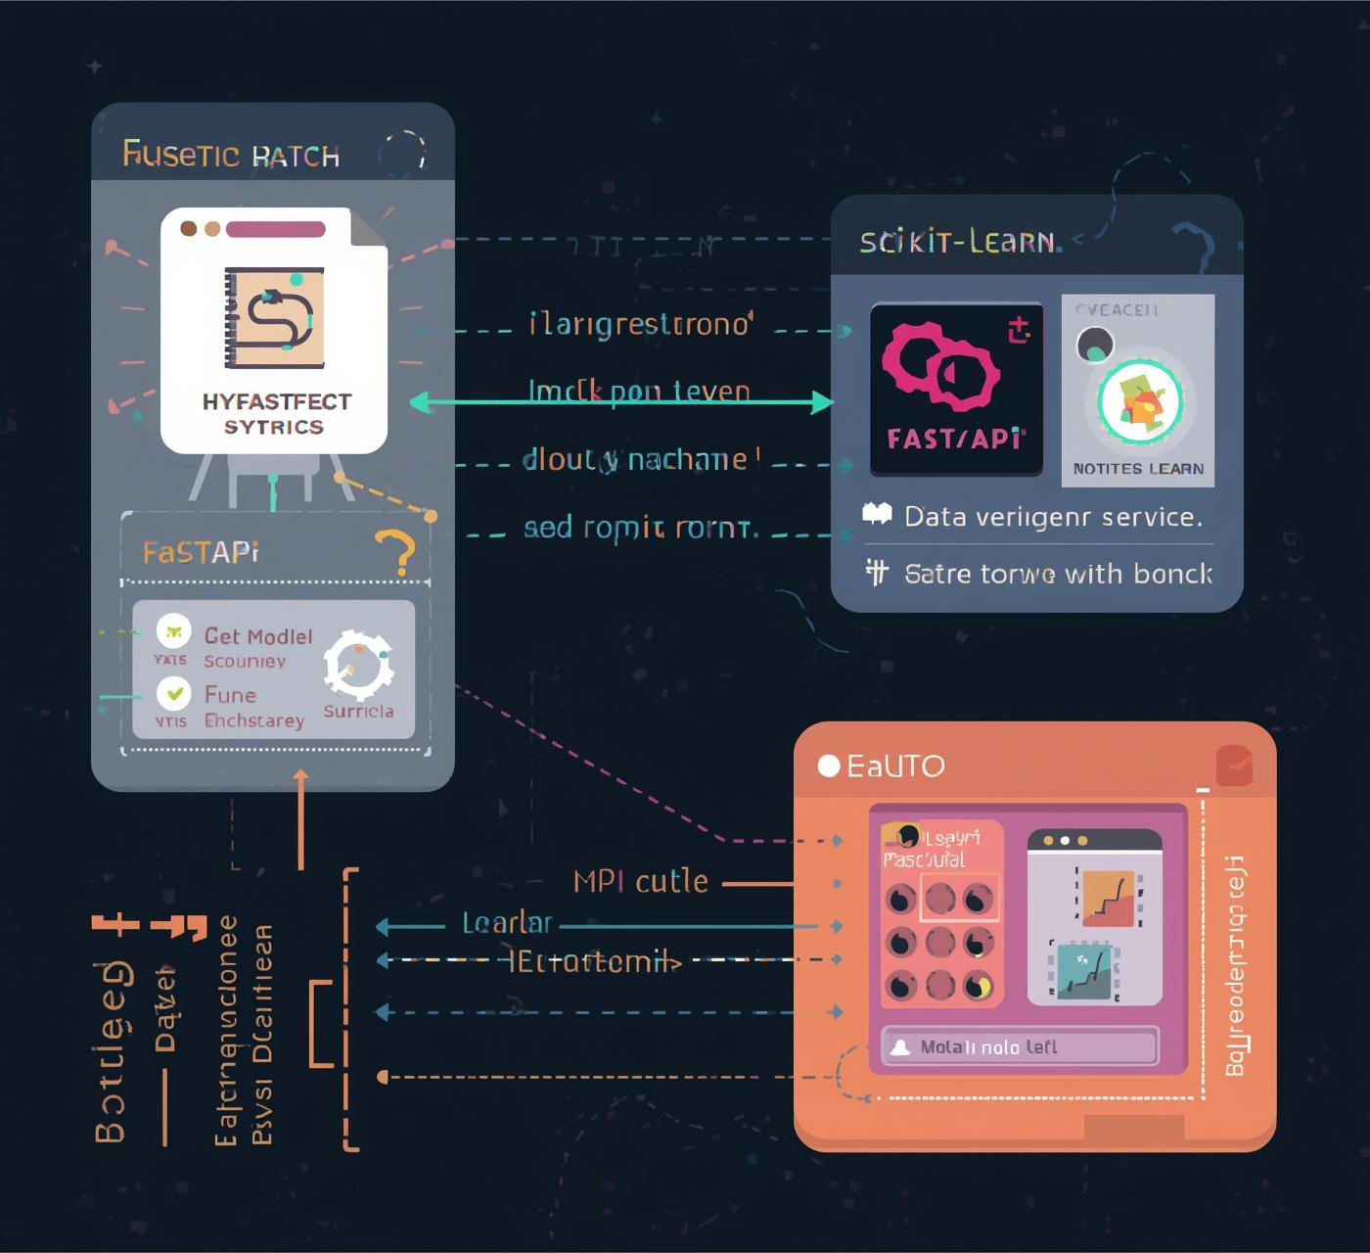
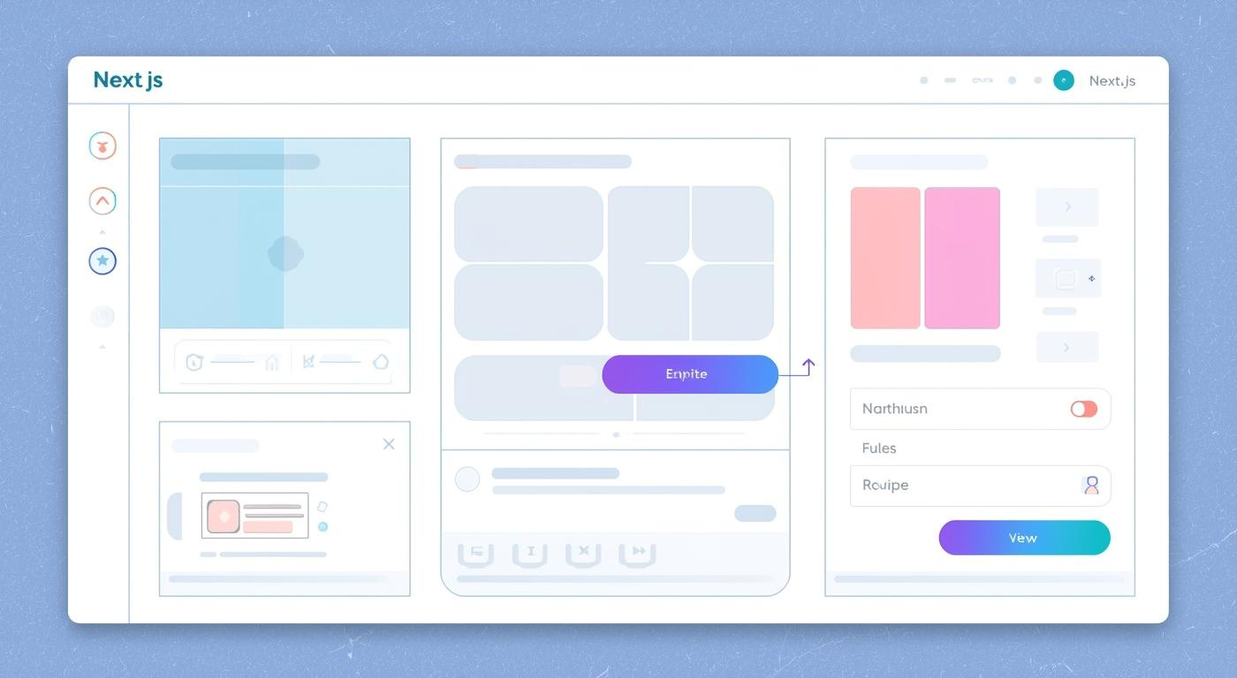
System Architecture (3-Tier Structure)
Tier 1: Frontend (Next.js)
Interactive chat interface for user input.
Sends user messages to the API via asynchronous requests.
Tier 2: Backend (FastAPI)
High-performance Python API server.
Hosts the /predict endpoint.
Loads and manages the pre-trained ML model.

Slide 5

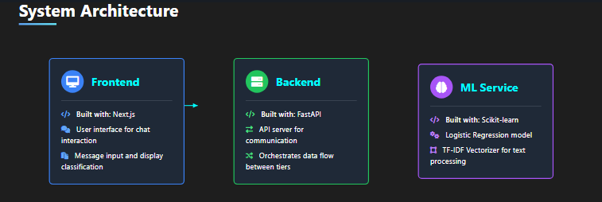
System Architecture
(3-Tier Structure)
Tier 3: ML Layer (Scikit-learn)
Core prediction engine.
Processes the text and returns the classification result.

Slide 6
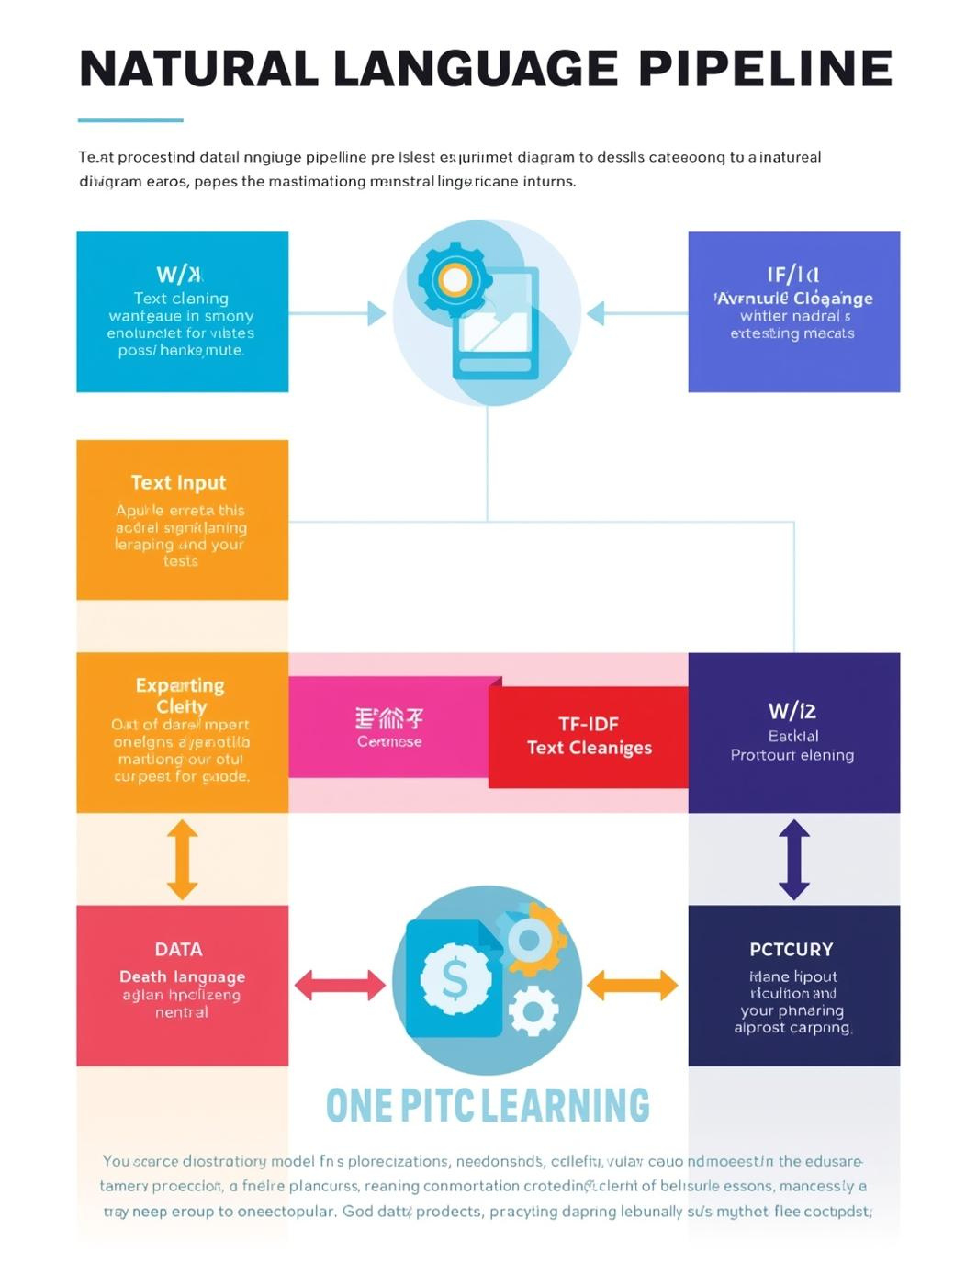
Data & NLP Pipeline
Understanding TF-IDF Vectorization for Effective Model Training
Dataset Source: Kaggle SMS Spam Collection.
Data Preparation & Manipulation:
Rigorous Text Cleaning (removing stopwords, punctuation, and lowercasing).
Synthetic Augmentation used to enrich the dataset with modern social engineering phrases.
Labels interpreted as 'Safe' and 'Unsafe'.
Vectorization (TF-IDF):
Converts cleaned text into numerical vectors.
TF-IDF assigns higher weights to terms that are frequent in 'Unsafe' messages but rare across all messages (e.g., 'urgent', 'account lock').

Slide 7
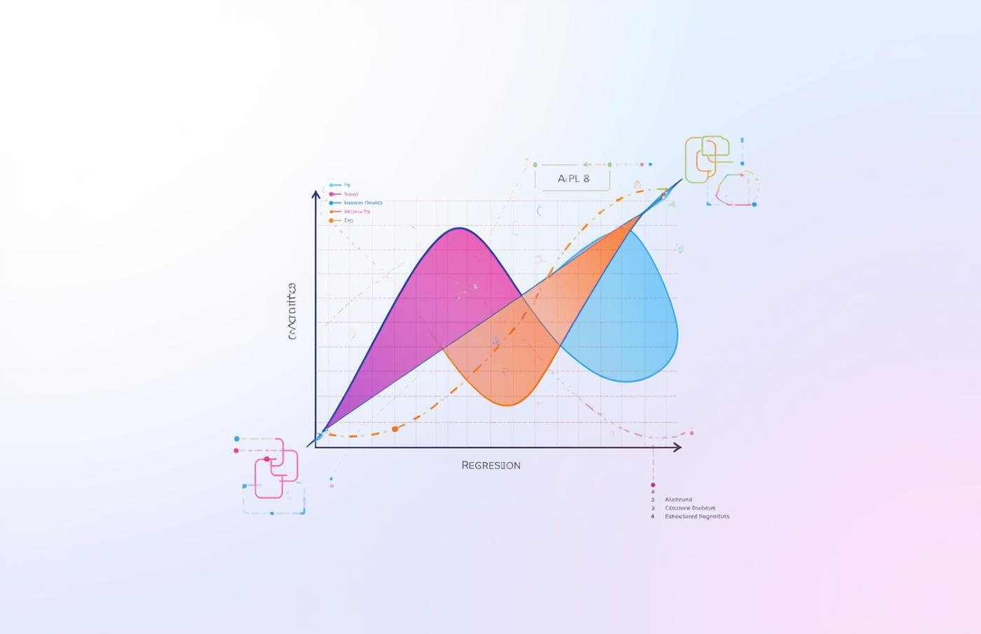
Logistic Regression and Rule-based Auto Labelling
Model Selected: Logistic Regression (LR).
Rationale for LR:
Efficiency: Extremely fast training and prediction time, ideal for real-time API response.
Simplicity: Provides a strong, easily interpretable baseline performance for linear classification problems.
Model Enhancements: Rule-based Auto Labelling: Implemented secondary rules to instantly flag highly suspicious inputs (e.g., specific URLs or known OTP request patterns) to boost precision.
Tools: Model and Vectorizer saved using joblib (or pickle) and loaded in FastAPI.

Slide 8


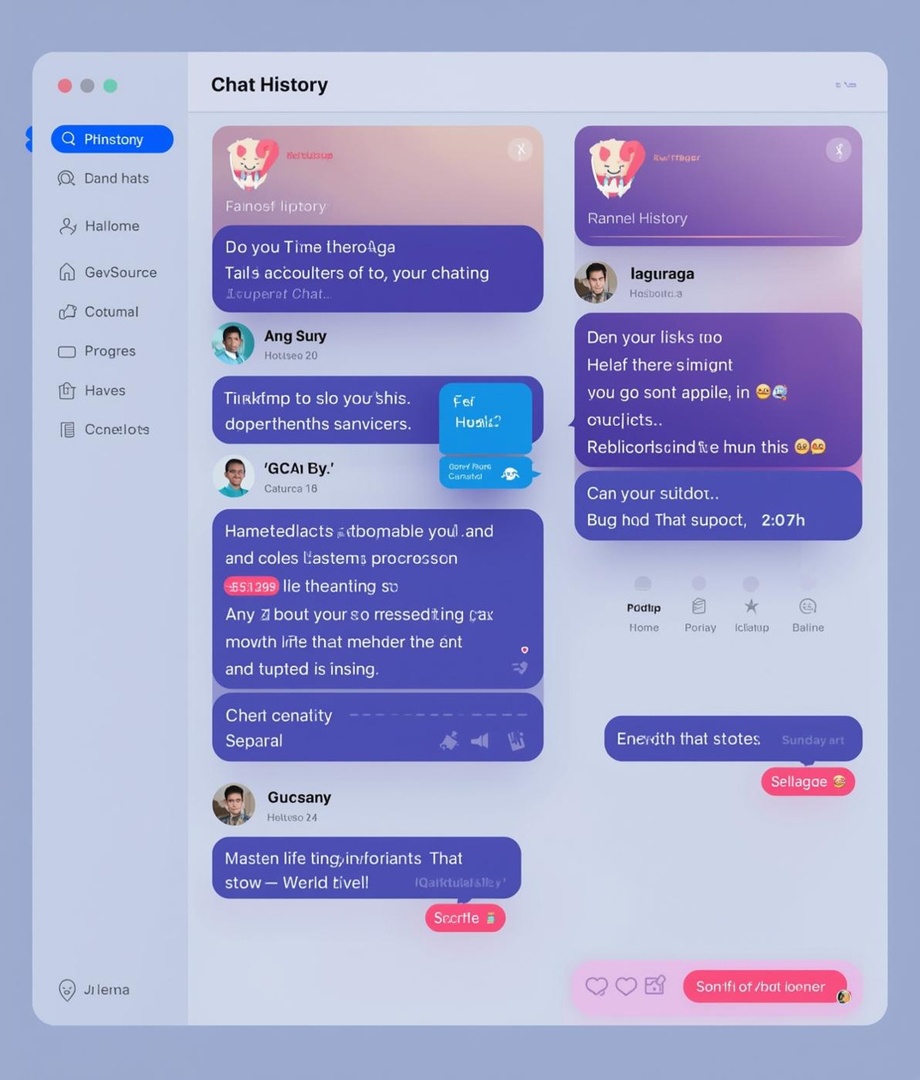

Key Features of the Chatbot
Real-time Prediction
Safe/Unsafe Classification
Chat History
User-Friendly Interface
Instant classification of incoming messages
Clear indication of message status
Stores logs for user transparency
Intuitive design for easy interaction

Slide 9
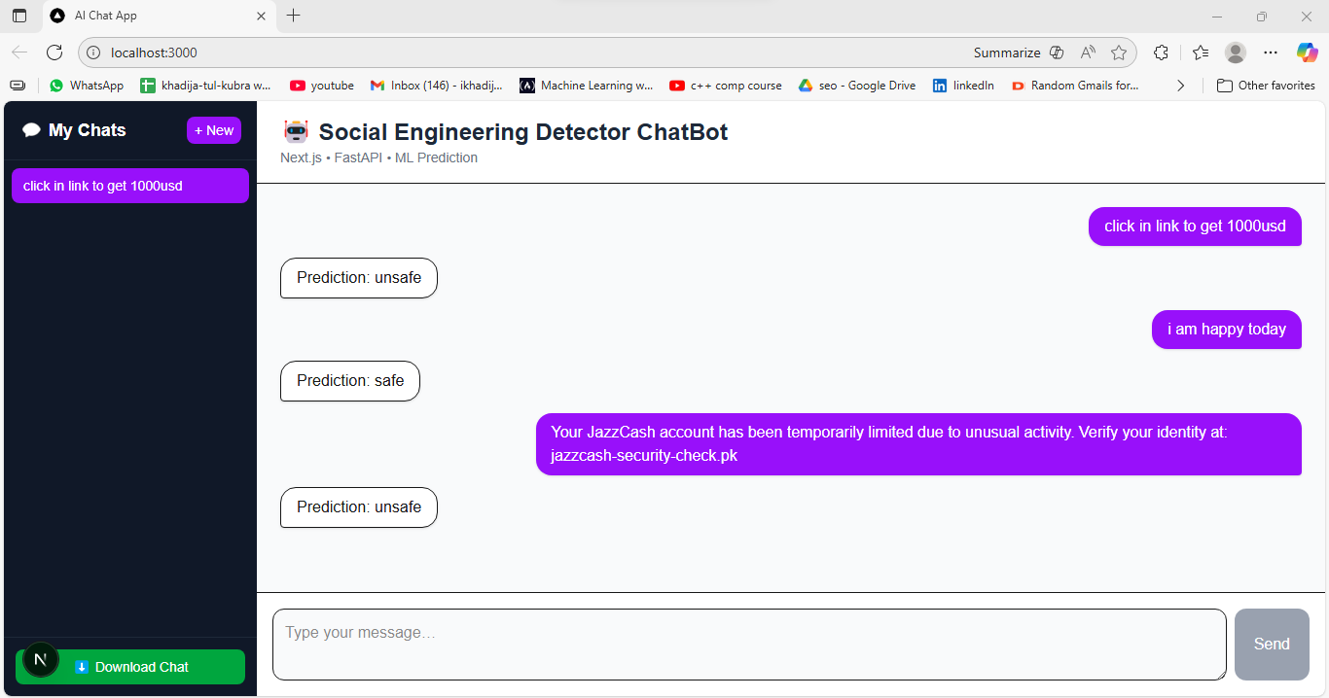
Working Demo
This shows the scenerios or suspicious texts are detected as unsafe

Slide 10

Conclusion & Future Scope
Enhancing AI Chatbot Capabilities with Advanced Techniques and Scalability
The project successfully developed an AI chatbot for detecting social engineering attacks. Future enhancements include incorporating Deep Learning models, like BERT, to improve accuracy and responsiveness. Additionally, scalability improvements will ensure the chatbot can handle larger datasets and extend its detection capabilities to a wider range of social engineering threats.

Slide 11

Thank You.
Feel free to reach out with questions!

